Slide 1
Fit Mirror-Virtual Shirt Try-On
Team
S Yashwanth (R23EA149)
M Susanth (R23EA172)
V Charith Reddy (R23EA153)

Slide 2
Problem Statement
Problem Statement:
Customers shopping online for shirts cannot accurately visualize how a shirt will fit and look on them, leading to uncertainty, dissatisfaction, and increased product returns.
Motivation :
Despite the convenience of online apparel shopping, customers still prefer physical trials to assess fit, color, and style. The lack of a real-time try-on experience limits purchase confidence. A virtual try-on solution, leveraging a webcam and AI-powered garment fitting, can help users visualize shirts on themselves before purchase — enhancing user satisfaction and reducing returns.

Slide 3
Product/ Solution - Innovation
1️⃣ Explanation & Problem Solving
Our innovation introduces an AI-powered Virtual Try-On platform
that allows users to visualize how different shirts fit and look on them
in real-time using their webcam.
It addresses major online shopping challenges such as uncertainty
about size, fit, and color suitability.
The solution detects the user’s body via computer vision and
overlays selected shirt models dynamically for a realistic fitting experience.
It helps customers make confident purchase decisions, reducing
return rates and enhancing satisfaction.
For retailers, this increases conversion rates, lowers logistics costs
from returns, and provides data-driven insights into customer preferences.

Slide 4
Product/ Solution - Innovation
2️⃣ Type of Innovation
Technological Innovation:
Utilizes Augmented Reality (AR) and Computer Vision to create a
real-time
shirt try-on experience through the user’s webcam.
Process Innovation:
Transforms traditional online clothing purchase processes by allowing
users to virtually test fit and style before buying.
Customer Experience Innovation:
Enhances buyer confidence and reduces purchase hesitation
through an I
nteractive, personalized shopping experience.

Slide 5
Product/ Solution - Innovation
3️⃣ Uniqueness Compared to Others
Unlike existing AR try-ons (e.g., Lenskart’s eyewear demo), this system focuses on apparel fitment using upper-body mapping and 3D garment overlay.
Provides real-time fit simulation instead of static image overlays, offering a more accurate and immersive experience.
Supports custom fabric texture visualization, size scaling, and color variant preview to help users find their perfect shirt.
Can be integrated with any e-commerce platform, making it a scalable plug-and-play solution for online clothing retailers.

Slide 6
Product/ Solution - Readiness Level
Stage: Idea Validation & Early Prototype
The concept has moved beyond ideation — a working prototype is being developed using webcam-based AR fitting for shirts.
Basic body detection and shirt overlay functionality is under testing.
User feedback from early interviews validates strong interest and purchase confidence improvement.
Proof of Concept (PoC):
A React-based web demo is under development that uses webcam input and AR overlay of shirts.
Early testing shows accurate upper-body alignment using pose detection (MediaPipe/AR.js).
Planned enhancements include texture realism and size scaling.

Slide 7
Product/ Solution - Readiness Level
Ideal Customer Profile – Summary
Customer Type:
Tech-savvy online shoppers aged 18–35, living in urban areas, who frequently buy fashion apparel online.
Key Traits:
Regular buyers on Myntra, Amazon, Ajio, Flipkart
Value style, convenience, and fit confidence
Use smartphones/laptops with webcam
Prefer interactive and visual shopping experiences
Pain Points:
Unsure about fit, size, and color accuracy when buying shirts online
Frustrated by returns and refund delays
Product images often don’t match real appearance
Goals & Motivations:
Want to visualize shirts before purchase
Seek trustworthy and engaging online shopping experiences
Aim to reduce time and effort in choosing the right apparel
Business ICP (B2B):
Online fashion retailers & clothing brands
Want to reduce returns, boost conversions, and enhance customer satisfaction
Looking to integrate AI + AR try-on technology for a modern, immersive experience

Slide 8
Product/ Solution - Readiness Level
Customer Persona
Name: Ajay Raman
Role: Fashion Designer & Owner – The Urban Streetwear
Business Type: Small casual wear boutique (6–10 employees)
Location: Yelahanka, Bengaluru
Background & Focus:
Passionate about modern streetwear design and digital innovation in fashion retail.
Wants to create a tech-driven customer experience that attracts young shoppers.
Goals & Motivations:
Improve online sales conversion by offering virtual try-on options.
Reduce in-store trial time and enhance purchase confidence.
Build a strong online presence through AR integration on Instagram and WhatsApp Shop.
Pain Points:
High in-store trial time but limited purchases.
Frequent online order cancellations due to sizing issues.
Competing boutiques are adopting online and AR-based strategies.
Budget Range: ₹75,000 – ₹2,00,000
Tech Preference: Instagram Shop, WhatsApp Business, AR Try-On Integration

Slide 9
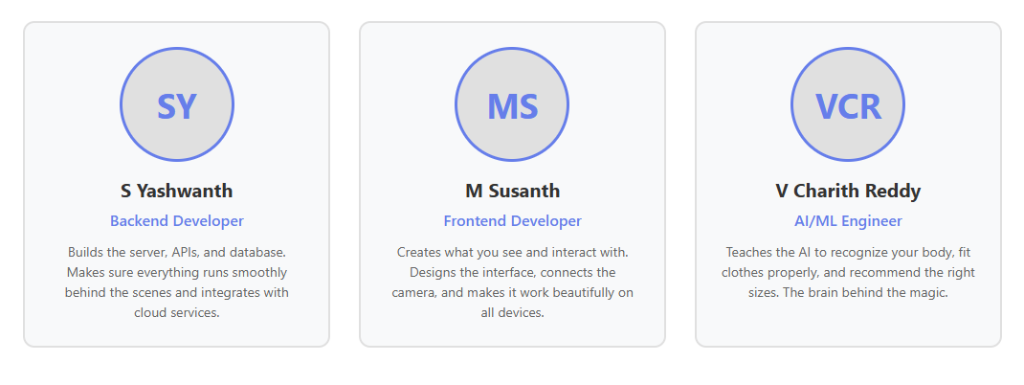
Team Size, Background, Strength /Capability and Resources
Individual Contribution to Product:
Designs the entire user interface - making it beautiful, intuitive, and easy to use for everyone
Integrates your device camera seamlessly so the try-on experience feels natural and instant
Creates the real-time video overlay effects that make shirts appear on your body
Ensures the app works perfectly on phones, tablets, and computers - responsive on all screens
Connects the app with Instagram and WhatsApp so boutiques can share try-on links with customers easily

Slide 10
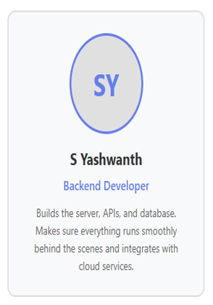
Team Size, Background, Strength /Capability and Resources
Individual Contribution to Product:
Designs and builds all the APIs that power the app - think of it as creating the highways that data travels on
Creates the backend systems that process your camera feed and uploaded photos in real-time
Builds the database that stores everything - clothing catalogs, user preferences, and analytics
Handles integration with AWS/Firebase so the app can scale when thousands of people use it
Implements security measures to protect user data and ensures we comply with privacy laws
Individual Contribution to Product:
Designs the entire user interface - making it beautiful, intuitive, and easy to use for everyone
Integrates your device camera seamlessly so the try-on experience feels natural and instant
Creates the real-time video overlay effects that make shirts appear on your body
Ensures the app works perfectly on phones, tablets, and computers - responsive on all screens
Connects the app with Instagram and WhatsApp so boutiques can share try-on links with customers easily

Slide 11
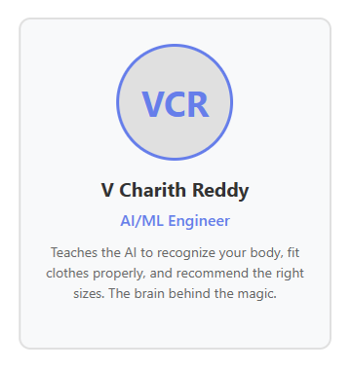
Team Size, Background, Strength /Capability and Resources
Individual Contribution to Product:
Designs and builds all the APIs that power the app - think of it as creating the highways that data travels on
Creates the backend systems that process your camera feed and uploaded photos in real-time
Builds the database that stores everything - clothing catalogs, user preferences, and analytics
Handles integration with AWS/Firebase so the app can scale when thousands of people use it
Implements security measures to protect user data and ensures we comply with privacy laws

Slide 12
Market Landscape - Market Potential, Competitors
Market Potential
Size (Total Spend of Market You’re Addressing):
The Virtual Apparel Try-On and Fashion Tech market in India is rapidly growing, driven by the surge in online shopping. The AI and AR-based virtual fitting market is estimated at ₹800 – ₹1,000 crores annually, with strong adoption expected among online fashion retailers and D2C apparel brands.This estimate is based on an average annual spend of ₹1–3 lakhs per brand for integrating AR/AI-based try-on features across 25,000+ small to mid-sized apparel retailers and online boutiques in India.
Customer Size Based on ICP Demographics:
Small to mid-sized apparel businesses (5–50 employees) selling through Instagram, Shopify, or online marketplaces.
Focus on urban fashion hubs such as Bengaluru, Mumbai, Delhi, and Hyderabad, where digital fashion innovation adoption is highest.
Expandable market to 50,000+ apparel retailers and e-commerce sellers across India and the Asia-Pacific region adopting AR try-on to enhance customer experience.

Slide 13
Market Landscape - Market Potential, Competitors
Competitors
Freshteam by Freshworks
Zoho People
SAP SuccessFactors
People Hum
Darwinbox
Uniqueness Compared to Competition:
AI-first approach for onboarding FAQs and exit interviews
Sentiment analysis and feedback summarization
Lightweight integration with existing HRMS and collaboration tools
Focus on SMEs with smaller budgets (₹2–5 lakhs/year) rather than enterprise-only solutions
Flexible deployment: cloud-based, API-driven, and multilingual support

Slide 14
Business Model & Strategy
Pricing Model Options:
Monthly / Annual Subscription (Primary Model)
Monthly Plan: ₹10,000 – ₹20,000/month (based on number of shirt models, storage, and integrations)
Annual Plan: ₹1 – ₹2 lakhs/year (discounted for annual payments)
Includes:
  Access to AR/AI-powered virtual try-on platform
  Integration with retailer’s website or Instagram Shop
  Dashboard for analytics (user engagement, conversion tracking)
  Basic technical support and software updates
Pay-per-Use (Optional Add-on)
Ideal for small boutiques and trial users.
₹5 – ₹10 per virtual try-on session or per customer preview beyond included quota.
Additional charges for:
  HD rendering and personalized fitting snapshots
  Branded customization and advanced analytics reports

Slide 15
Business Model & Strategy
Freemium Model (Optional for Startups / Small Boutiques)
Free basic plan for small retailers (<10 products).
Allows limited virtual try-ons using a default shirt catalog.
Paid upgrades unlock:
  Custom shirt uploads
  Brand logo integration
  Advanced visualization and AR depth mapping features
One-time License (Enterprise / White-Label Model)
For large fashion brands or e-commerce platforms wanting self-hosted or white-labeled solutions.
Pricing: ₹50,000 – ₹1,00,000 per license (based on customization and integration scope).
Includes:
  On-premise deployment
  API integration with existing e-commerce system
  Full control over data and brand design
Revenue Growth Potential
Year 1: Focus on small boutiques and local fashion stores (pilot phase).
Year 2–3: Expand to mid-size online retailers and fashion chains.
Long-Term: Introduce full-body virtual try-on and integrate with major e-commerce platforms (Amazon, Myntra, Shopify).

Slide 16
Business Model & Strategy
Revenue Forecast (Illustrative – Start-up Stage)
Year | Target Customers | Pricing Model Mix | Estimated Revenue (₹) | Key Focus / Milestones
Year 1 | 10–15 small fashion boutiques | Freemium + Basic Monthly Plans | ₹2 – ₹3 lakhs | Prototype testing, early customer onboarding, collecting feedback
Year 2 | 30–40 boutique stores & local retailers | Monthly / Annual Subscriptions | ₹6 – ₹8 lakhs | Product refinement, marketing expansion, improve try-on accuracy
Year 3 | 75–100 online apparel sellers | Annual Subscriptions + Pay-per-Use | ₹15 – ₹20 lakhs | Add dashboard analytics, expand to multiple cities
Year 4 | 150–200 apparel retailers & small brands | Subscriptions + Enterprise Licenses | ₹25 – ₹35 lakhs | Strategic partnerships, introduce 3D fit and texture simulation
Year 5 | 300+ national & regional fashion brands | Mix of all models | ₹45 – ₹60 lakhs | Scale operations, integrate with e-commerce platforms (Shopify, Amazon Fashion)

Slide 17
Business Model & Strategy
Channels (Go-to-Market Approach)
B2B (Primary Channel)
Selling the try-on system directly to:
Boutique stores
Instagram/Shopify apparel sellers
Small to mid-sized online clothing brands
E-commerce startups
Methods:
Direct sales
Website demos
Cold outreach to fashion retailers
B2B partnerships (Shopify apps, Instagram store tools)
B2C (Secondary / Long Term)
Providing the try-on interface directly to end-users through:
Integrated retailer websites
Mobile-friendly try-on tool
Social media try-on experience (Instagram filter / embedded try-on)

Slide 18
Total Budget, Required Support and Regulation
1. Total Estimated Budget
Total Budget Required: ₹3,50,000 – ₹5,00,00
This includes MVP development, scaling, deployment, and product launch preparation.
2.Cost Breakdown (Different Heads)
Hardware / Infrastructure
🔹 Hardware / Infrastructure
Item Cost (₹)
Cloud Hosting (AWS/Vercel) 20,000 – 40,000
GPU Compute for Pose Detection (Optional) 30,000 – 50,000
Storage for Shirt Assets 5,000 – 10,000
Testing Devices (Mobile/Laptop) 20,000 – 30,000
Subtotal: ₹75,000 – ₹1,20,000

Slide 19
Total Budget, Required Support and Regulation
🔹 Resources (Human Capital)
Role Duration Cost (₹)
AI/AR Developer 2–3 months 80,000 – 1,20,000
Frontend Developer 2 months 50,000 – 70,000
Backend Developer 2 months 40,000 – 60,000
UI/UX Designer 1 month 20,000 – 30,000
Subtotal: ₹1,80,000 – ₹2,80,000
🔹 Marketing & Promotion
Item Cost (₹)
Social Media Ads 10,000 – 20,000
Influencer Collaborations 5,000 – 15,000
Product Video Production 10,000 – 15,000
Subtotal: ₹25,000 – ₹50,000
🔹 Administrative Costs
Item Cost (₹)
Domain + Website 2,000 – 5,000
Legal/LLP Registration 5,000 – 15,000
Miscellaneous 5,000 – 10,000
Subtotal: ₹12,000 – ₹30,000

Slide 20
Total Budget, Required Support and Regulation
3. Budget for MVP Only
Cost Category Estimated Cost (₹)
Basic AI try-on prototype 60,000 – 80,000
Frontend dashboard + camera module 20,000 – 30,000
Minimal backend (shirt upload) 10,000 – 20,000
Testing & QA 5,000 – 10,000
Hosting for MVP 5,000 – 10,000
Total MVP Budget: ₹1,00,000 – ₹1,40,000
4. Budget for Final Product
Component Cost (₹)
Full AR engine + warping model 80,000 – 1,20,000
Mobile optimization 20,000 – 40,000
Admin dashboard + analytics 30,000 – 50,000
Cloud scaling & security 25,000 – 40,000
Marketing launch 25,000 – 50,000
Total Final Product Budget: ₹2,00,000 – ₹2,80,000

Slide 21
Summary for the total budget
Total Budget: ₹3.5–5 lakhs
MVP Budget: ₹1–1.4 lakhs
Final Product Budget: ₹2–2.8 lakhs
Cost Heads: Infra, Resources, Marketing, Admin
Support Needed: Technical, Business, Marketing, Institutional

Slide 22
🙏 Thank You

